Slide 1
21IT1906 DevOps

Slide 2
OBJECTIVES
To impart Knowledge on the following topics:
To introduce DevOps terminology, definition & concepts
To understand the different Version control tools like Git, Mercurial
To understand the concepts of Continuous Integration/ Continuous Testing/ Continuous Deployment)
To understand Configuration management using Ansible
Illustrate the benefits and drive the adoption of cloud-based Devops tools to solve real world problems.

Slide 3
UNIT - I INTRODUCTION TO DEVOPS
Devops Essentials
Introduction to AWS, GCP, Azure
Version control systems: Git and Github - Gerrit Code review.

Slide 4
What is DevOps?
DevOps is a culture which promotes collaboration between Development and Operations Team to deploy code to production faster in an automated & repeatable way.
The word 'DevOps' is a combination of two words 'development' and 'operations.'

Slide 5
BENEFITS OF DEVOPS
Shorten the development lifecycle
DevOps helps to deliver software faster and more reliably.
Improve software quality
DevOps helps to ensure that software is built, tested, and released more frequently.
Bridge the gap between development and operations
DevOps unites development and operations teams through collaboration and automation.
Empower developers
DevOps gives developers more ownership and control over the delivery of software.

Slide 6
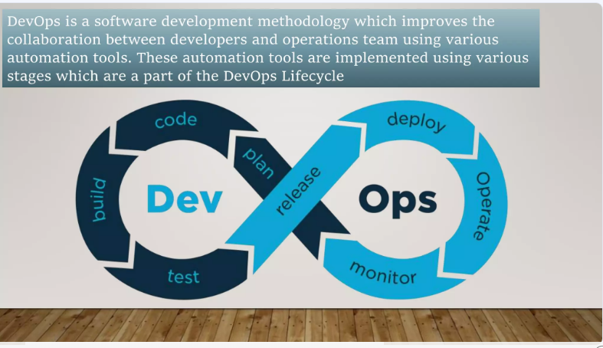

Slide 7
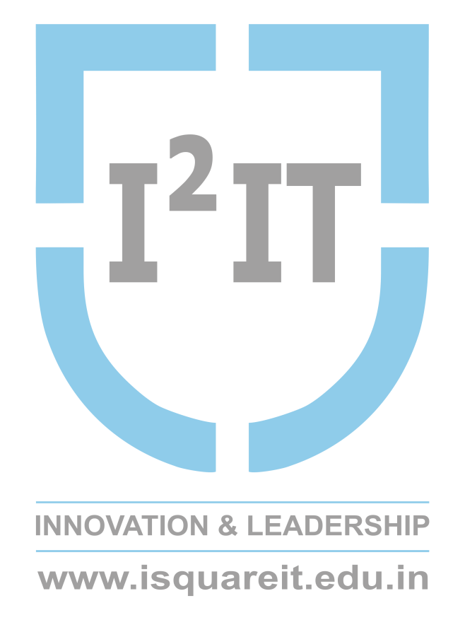
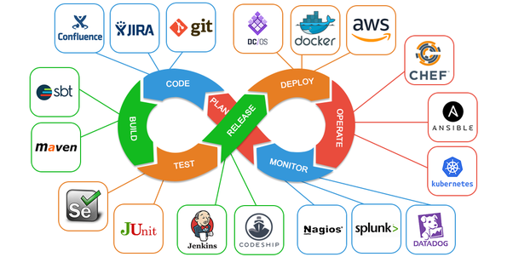
DevOps Lifecycle
Source: https://5gigs.com/global-devops-tool-market-2019-report-spotlight-on-regional-analysis-industry-growth-and-company-profile/

Slide 8
DevOps principles include:
Collaboration
Automation
Integration
Rapid feedback cycles
Data-based decision making
Customer-centric decision making
Constant improvement
Responsibility throughout the life cycle
Failure as a learning opportunity

Slide 9
Roles and Responsibilities of a DevOps Engineer
Develop large scale software solutions in at least one of these languages Python, .NET, Java, and JavaScript.
Hands-on experience with Cassandra, Elasticsearch, and MySQL.
Linux server administration experience or a deep understanding of Linux/Unix
Hands-on experience using Puppet, or Chef, or any other configuration management tool.

Slide 10
Prototype, develop and apply software integrations based on user feedback.
Implement automation tools and frameworks (CI/CD pipelines).
Implement cloud (AWS, Azure, GCP) computing ability to deploy upgrades and fixes.
Able to carry out approaches such as risk-management, clustering, load balancing, and failover.
Conduct system tests for security, performance, and availability.

Slide 11
some popular DevOps tools:
Version Control: Git, GitHub, GitLab.
Continuous Integration/Continuous Deployment (CI/CD): Jenkins, CircleCI, GitLab CI, Travis CI.
Configuration Management: Ansible, Puppet, Chef.
Containerization: Docker, Kubernetes.
Monitoring and Logging: Prometheus, Grafana, ELK Stack (Elasticsearch, Logstash, Kibana).
Infrastructure as Code (IaC): Terraform, CloudFormation.

Slide 12
When choosing a DevOps tool, you can consider things like:
Integration with other tools
API support
Cross-platform support
Automation of software development processes
Customizations
Ease of use and management
Performance
Price
Support for continuous integration and continuous delivery
Cloud support

Slide 13
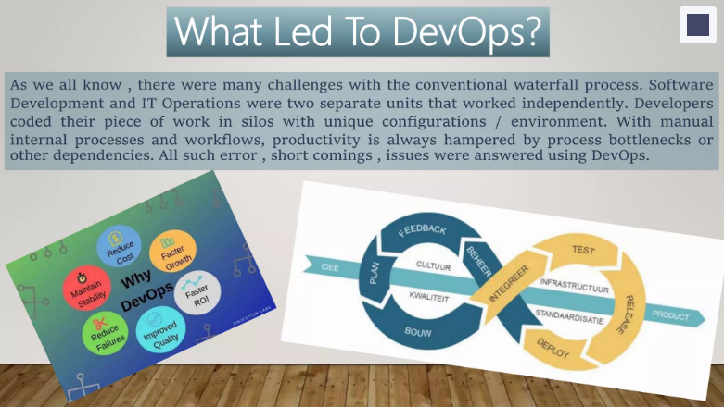

Slide 14
DevOps Lifecycle
Plan: Define the project and gather requirements.
Develop: Write code and implement features.
Build: Compile and package the application.
Test: Automated testing to ensure quality.
Release: Deploy the application to production.
Deploy: Make the application available to users.
Operate: Monitor and maintain the application.
Monitor: Gather metrics and feedback for continuous improvement.

Slide 15
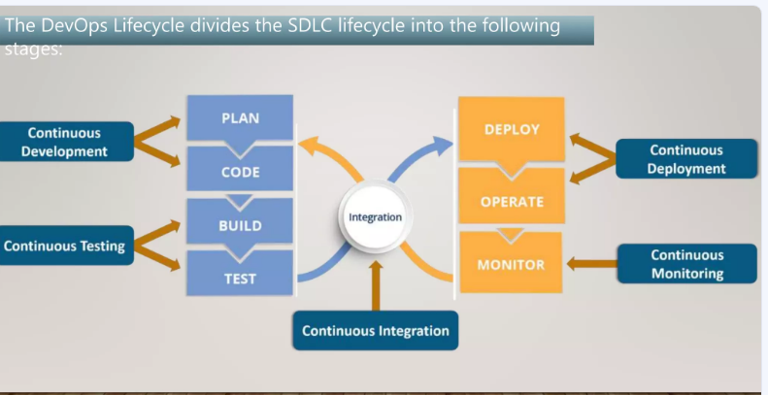

Slide 16
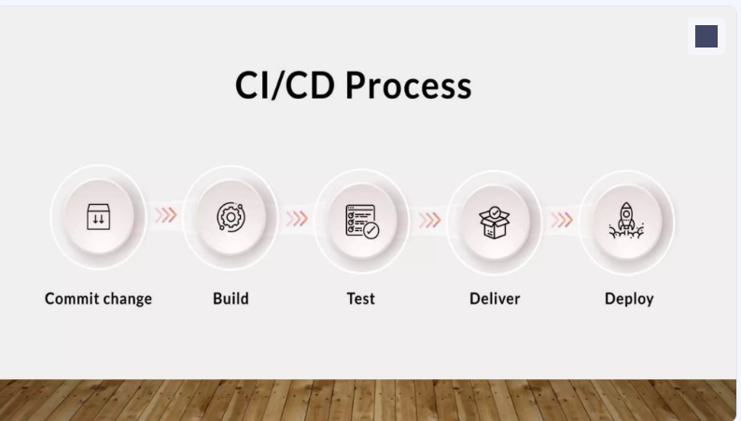

Slide 17
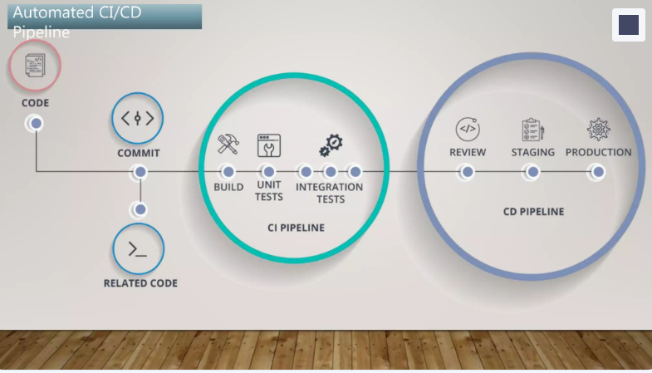

Slide 18
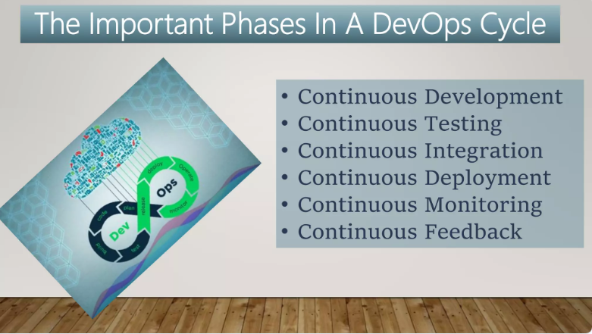

Slide 19
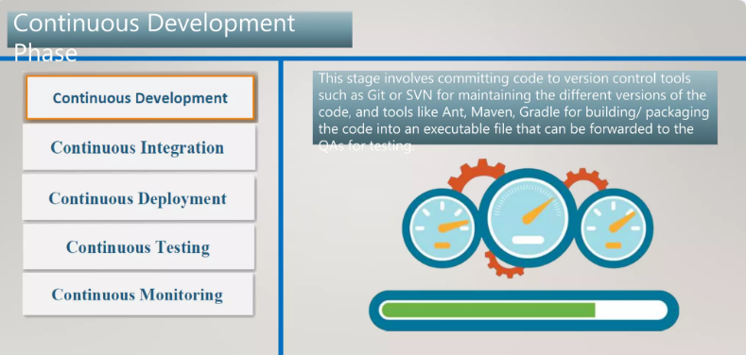

Slide 20
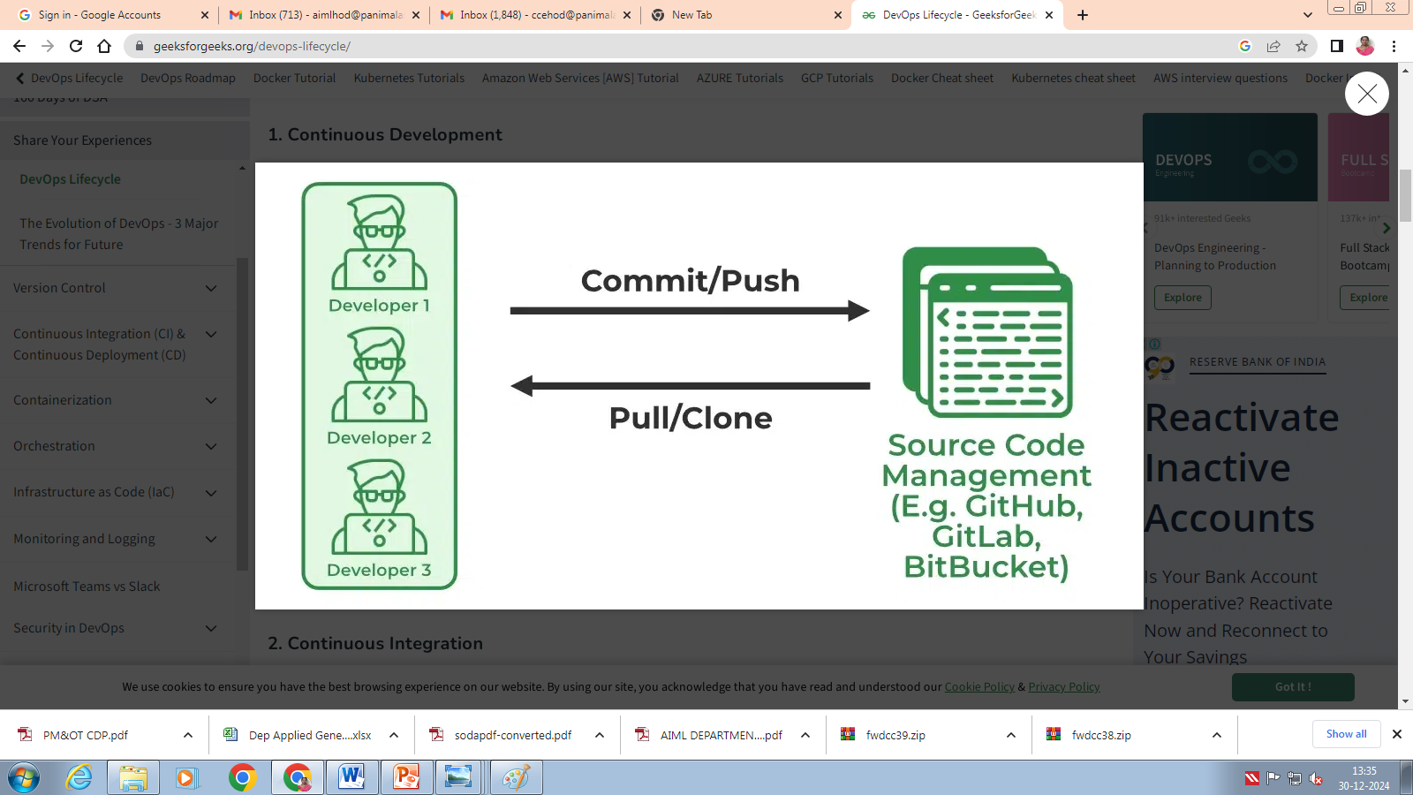
In Continuous Development, code is generated by the developer and every time a piece of code is created, it is tested, built, and deployed into production. Continuous Development which improves the standard of the code and removes flaws, vulnerabilities, and defects.

Slide 21
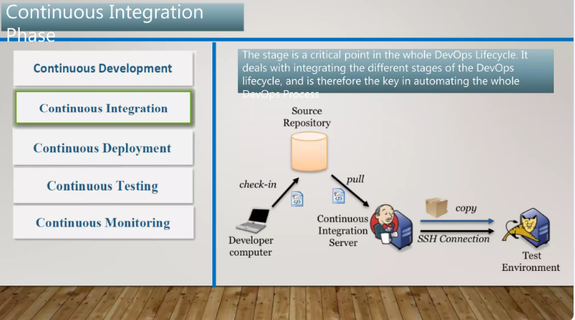

Slide 22
Continuous Integration can be explained mainly in 4 stages in DevOps. They are as follows:
Getting the Source Code from SCM ( Source Code Management)
Building the code
Code quality review
Storing the build artifacts

Slide 23
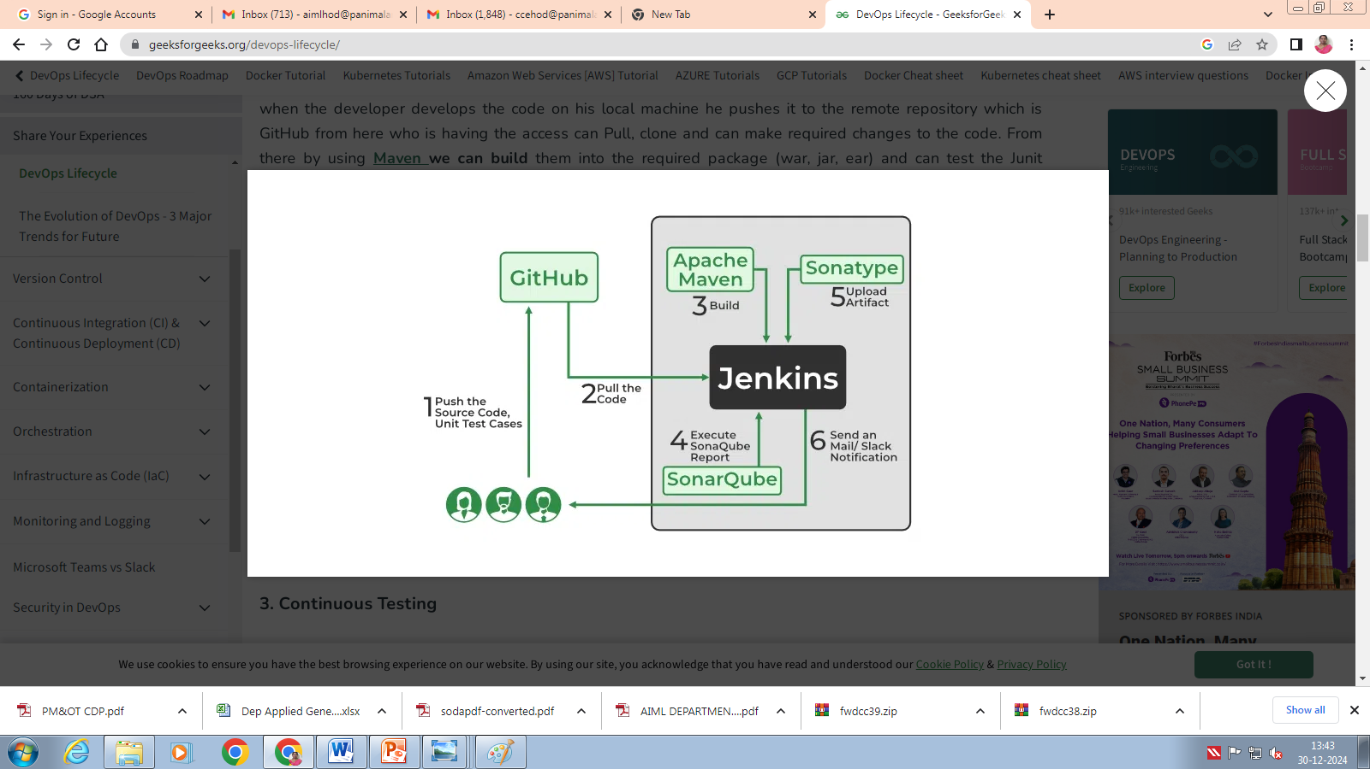
In Continuous Integration and we can use any of the tools based on our requirement and of the most popular tools are GitHub for source code management(SCM) when the developer develops the code on his local machine he pushes it to the remote repository which is GitHub from here who is having the access can Pull, clone and can make required changes to the code. From there by using Maven we can build them into the required package (war, jar, ear) and can test the Junit cases.SonarQube performs code quality reviews where it will measure the quality of source code and generates a report in the form of HTML or PDF format. Sonatype will help us to store the artifacts that are build by using Maven and this whole process is achieved by using a Continuous Integration tool Jenkins.

Slide 24
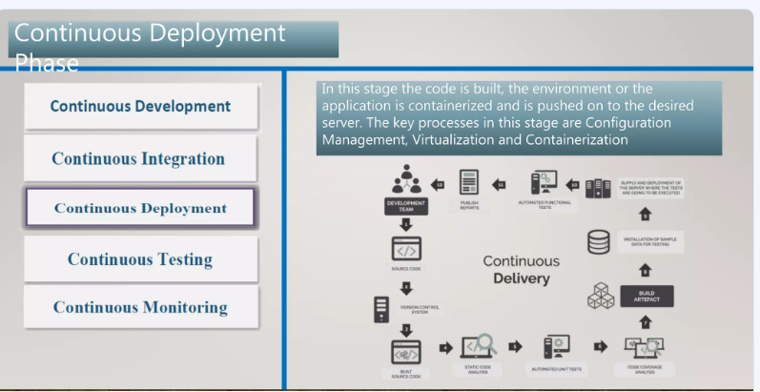

Slide 25
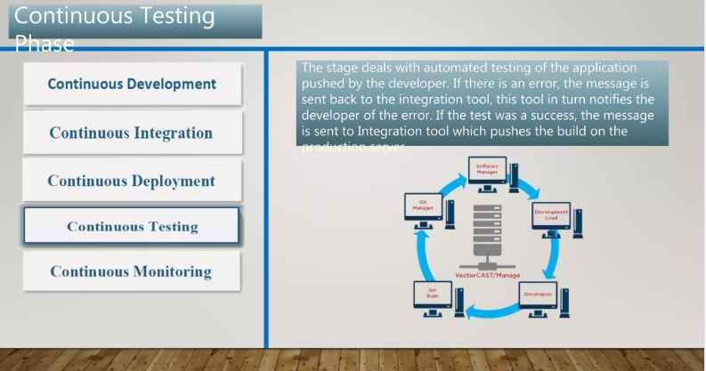

Slide 26
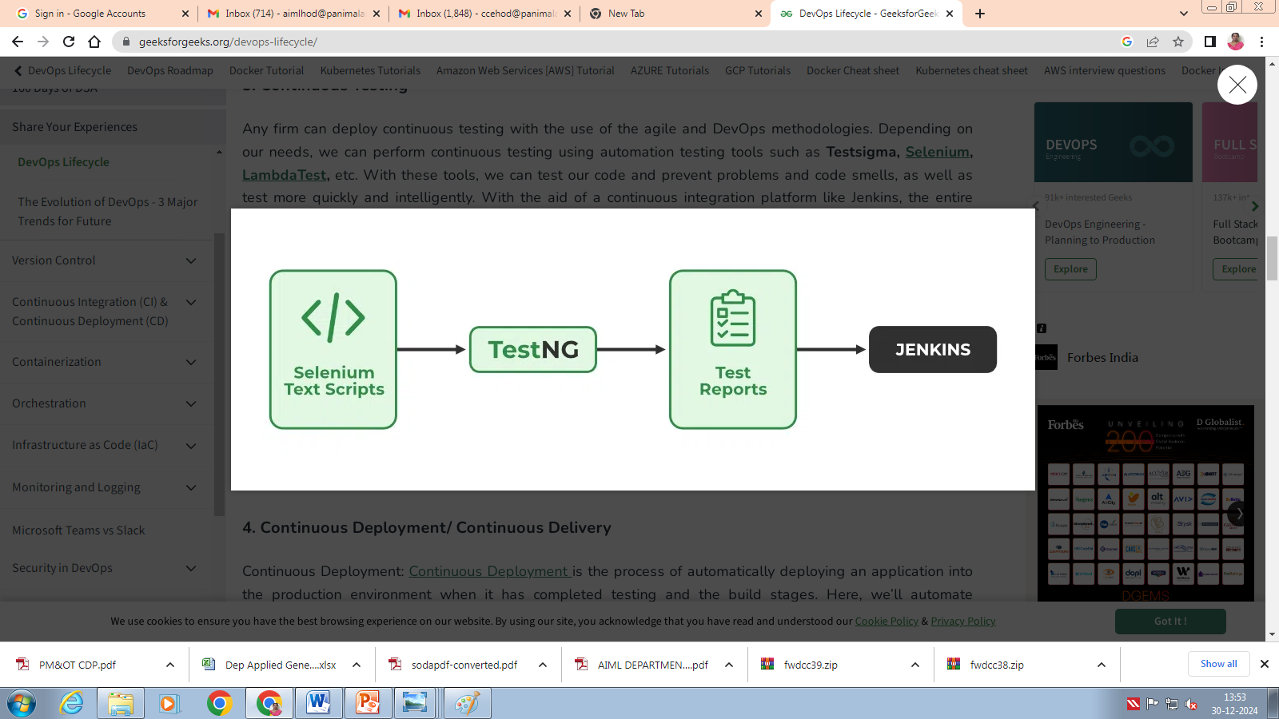
Depending on our needs, we can perform continuous testing using automation testing tools such as Testsigma, Selenium, LambdaTest, etc. With these tools, we can test our code and prevent problems and code smells, as well as test more quickly and intelligently. With the aid of a continuous integration platform like Jenkins, the entire process can be automated, which is another added benefit.

Slide 27
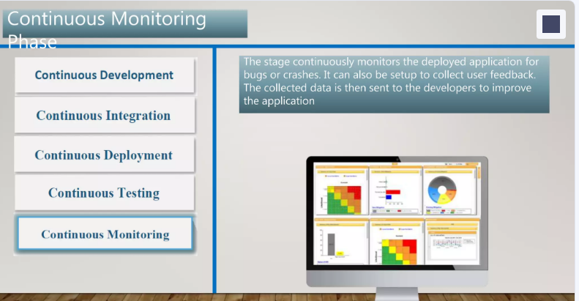

Slide 28
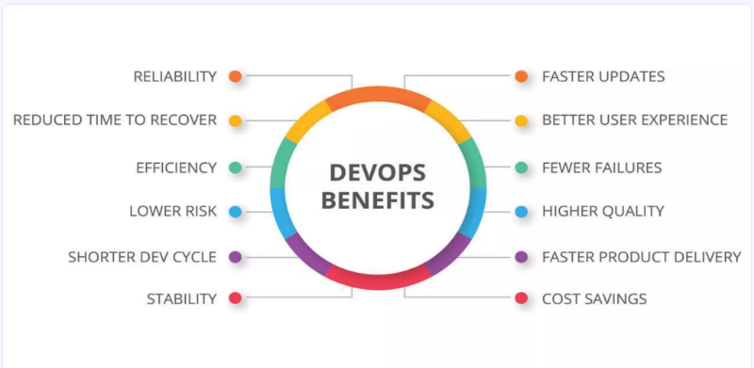

Slide 29
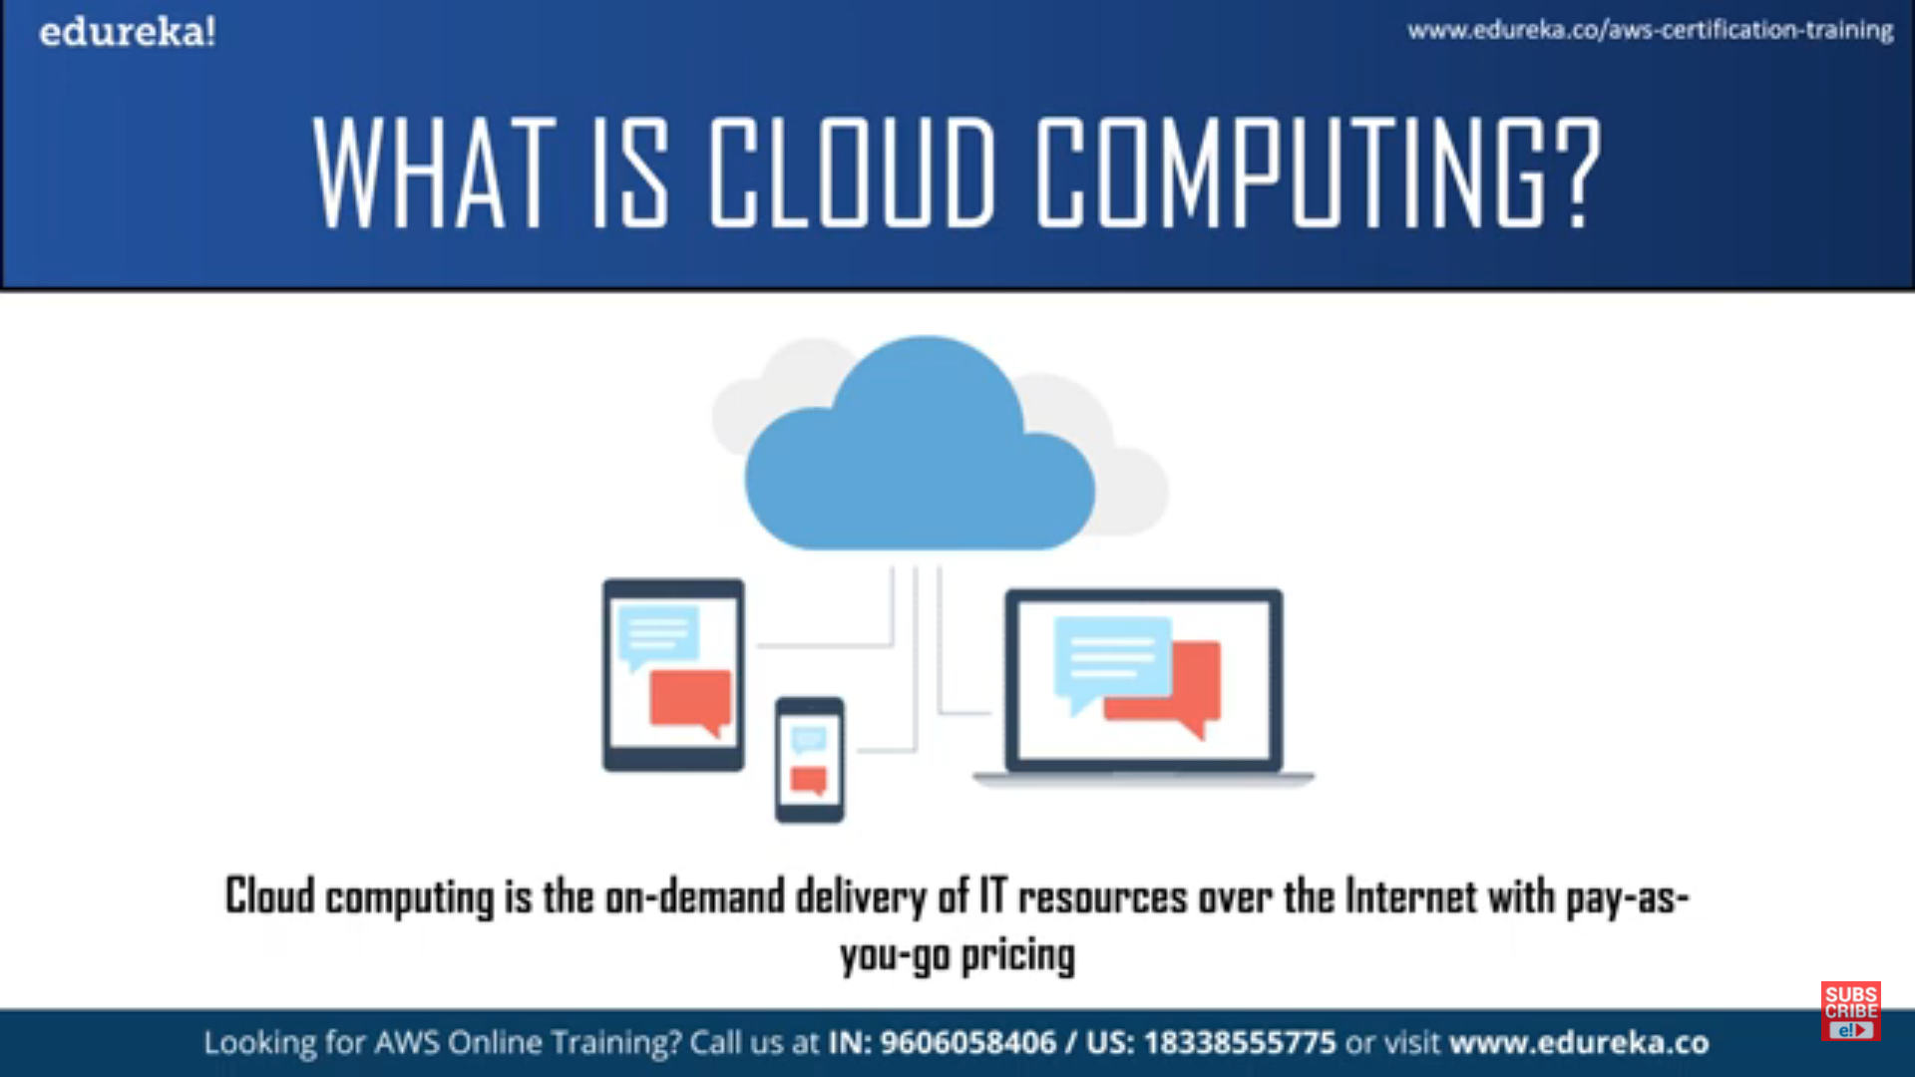

Slide 30
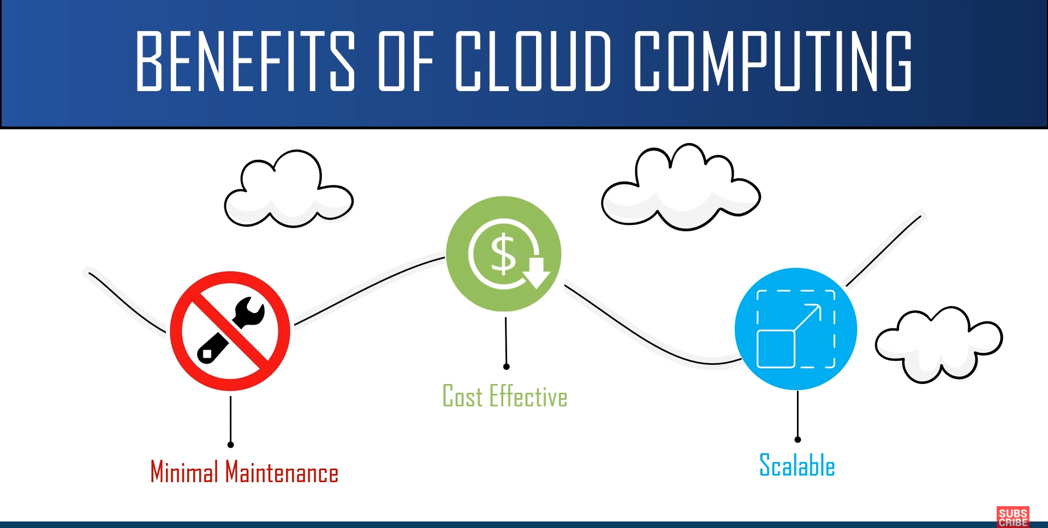

Slide 31
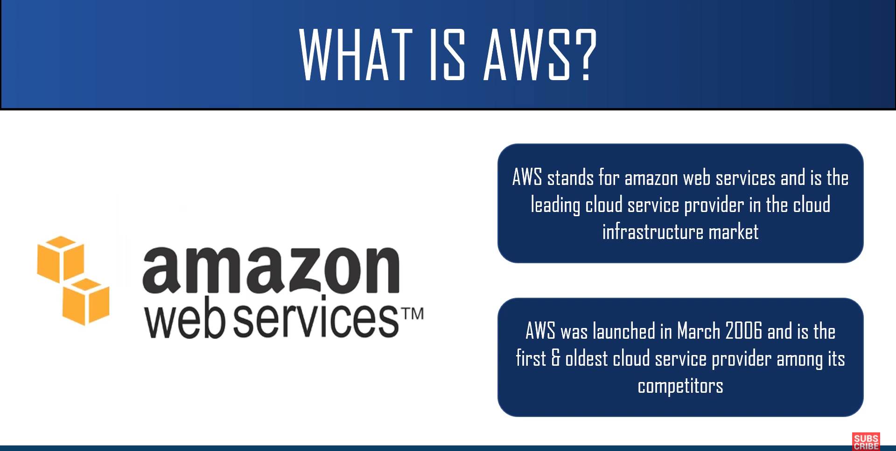

Slide 32
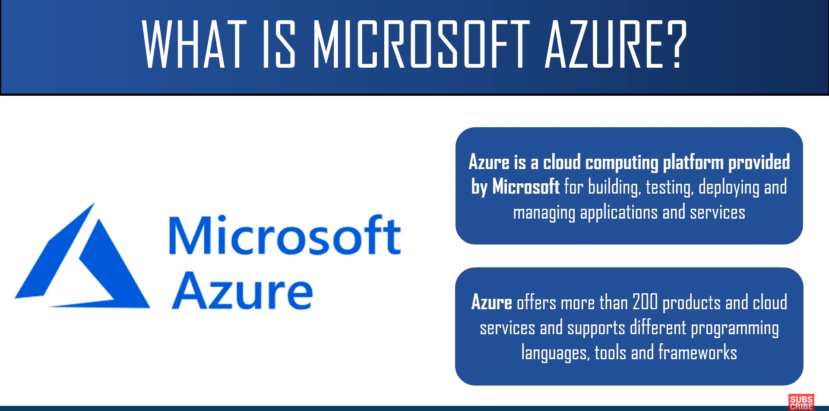

Slide 33
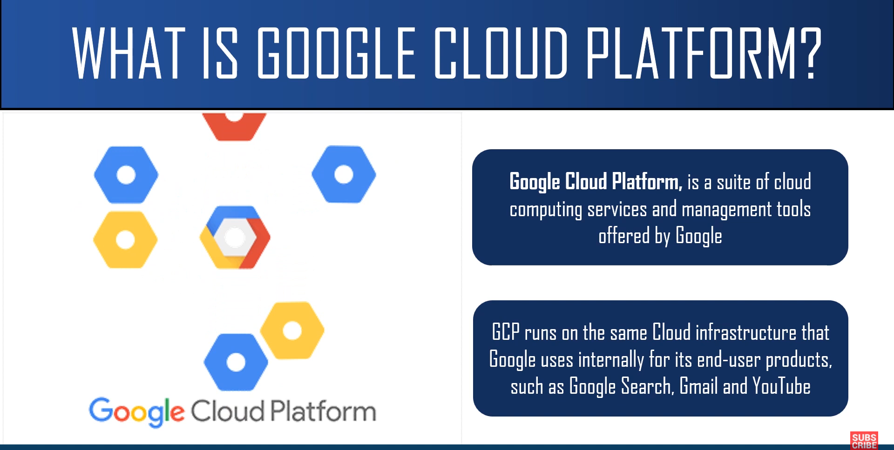

Slide 34


Slide 35
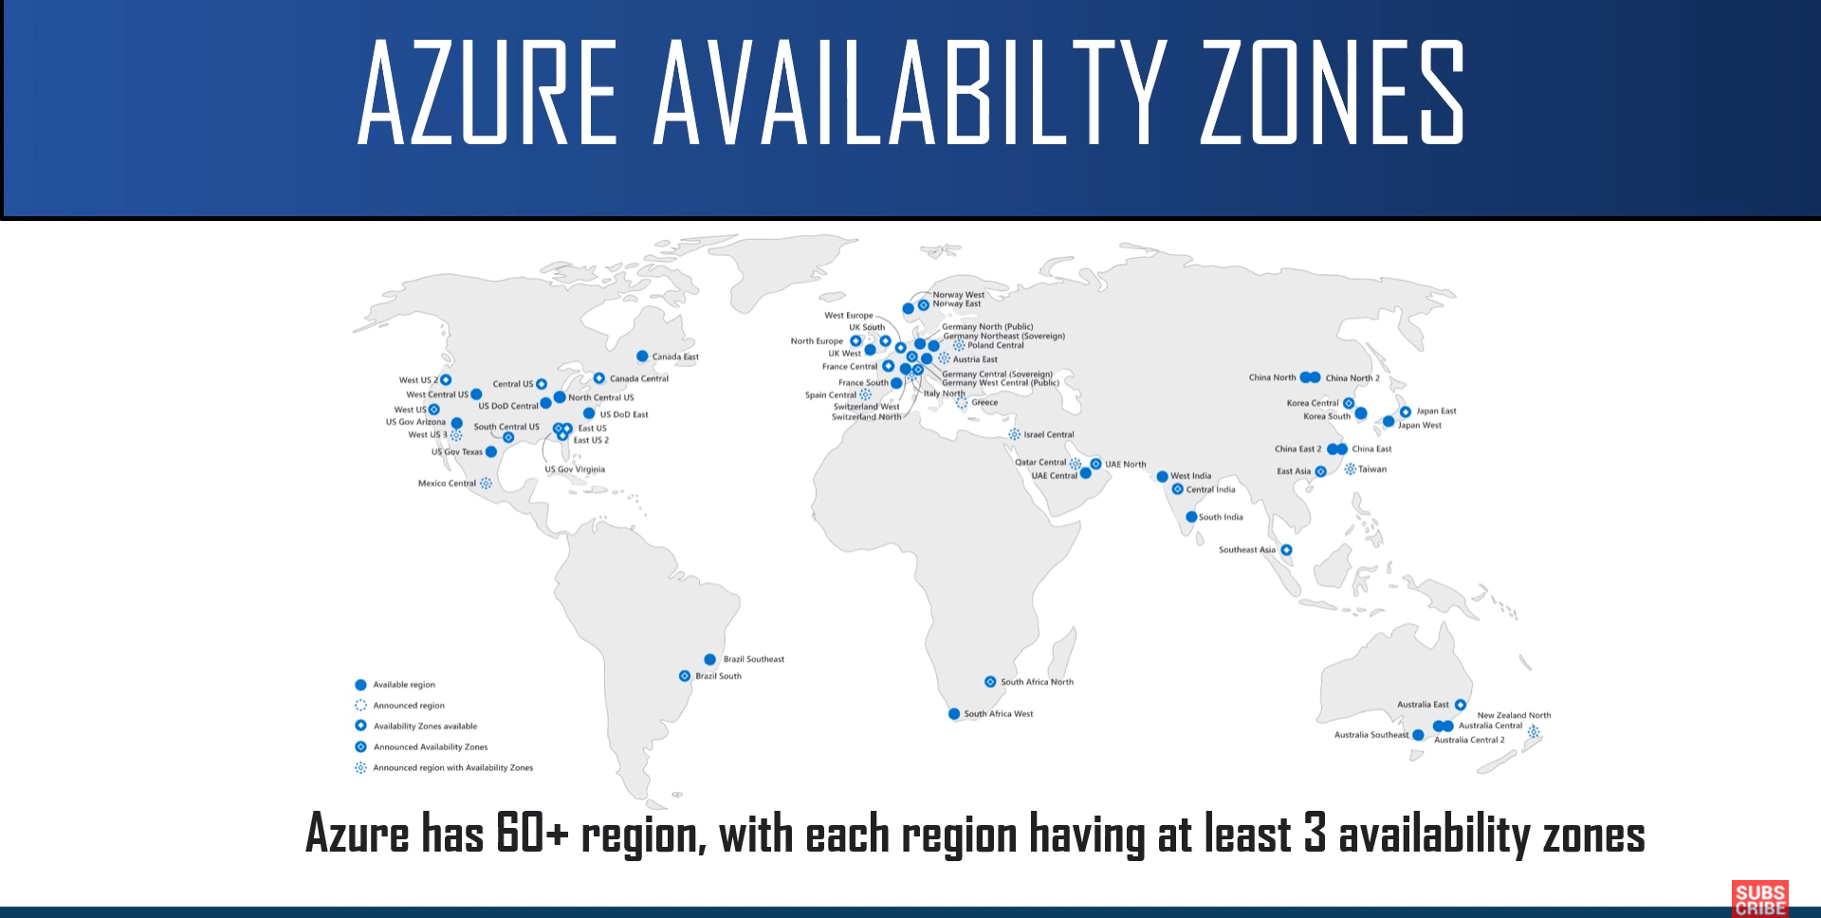

Slide 36
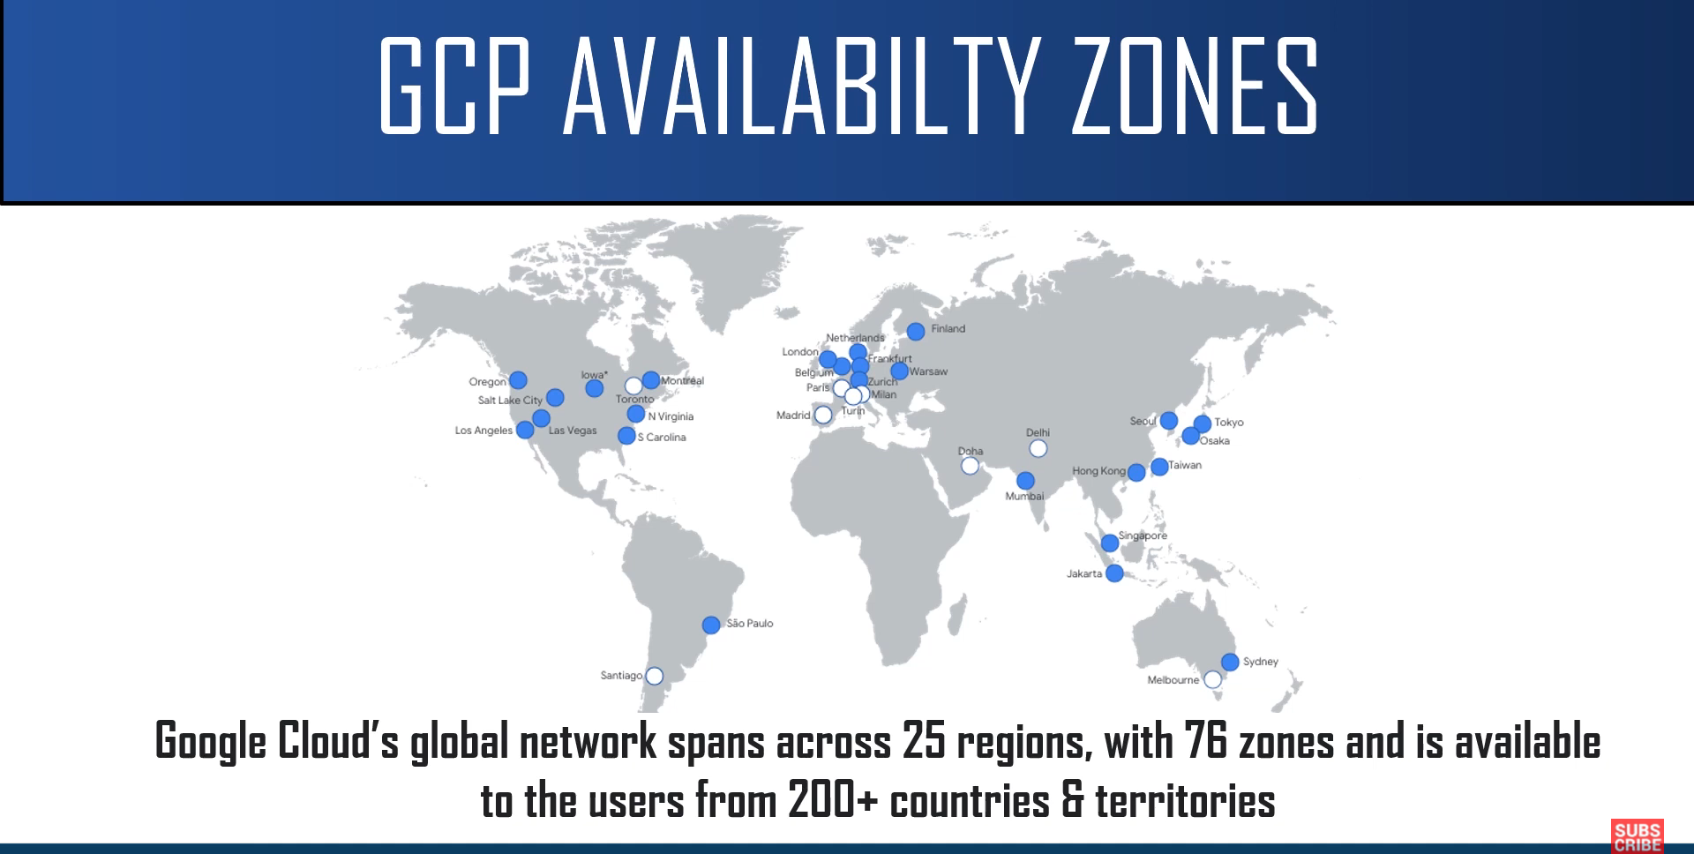

Slide 37
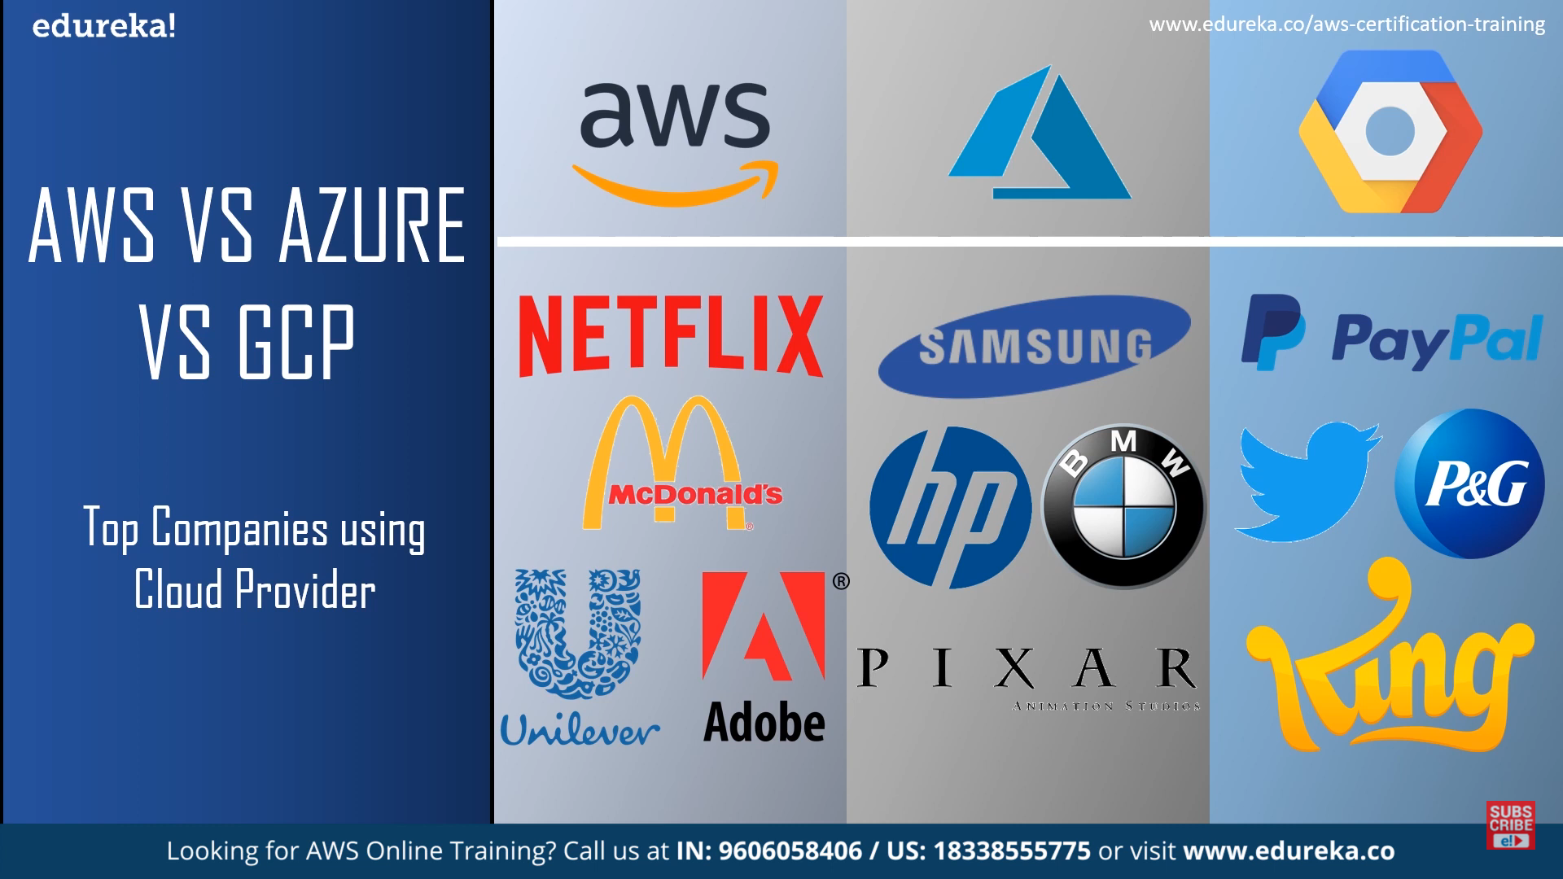

Slide 38
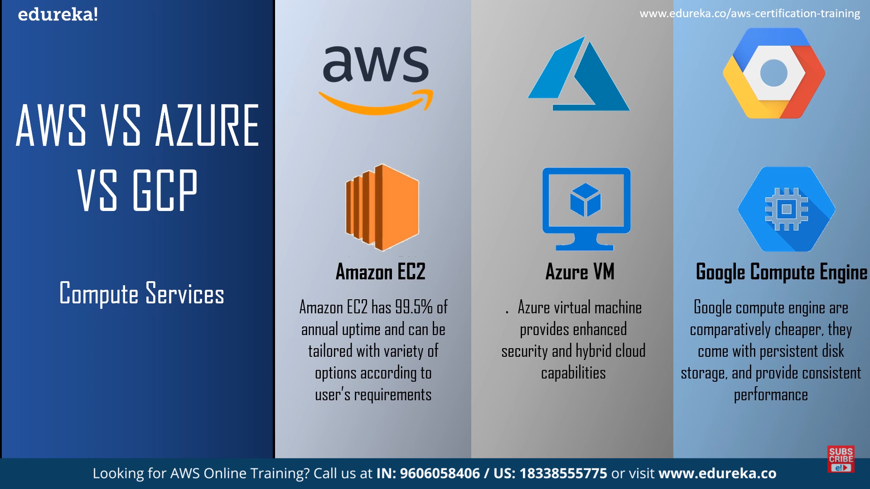

Slide 39
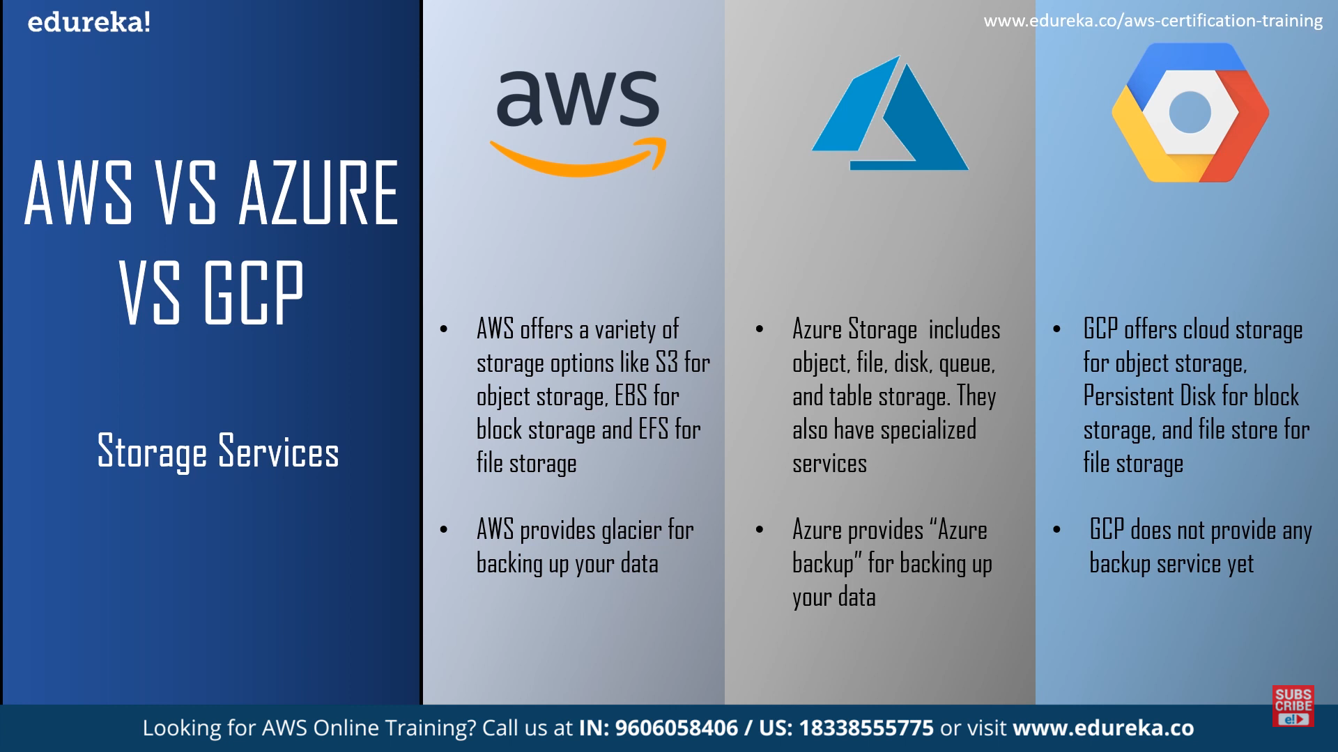

Slide 40
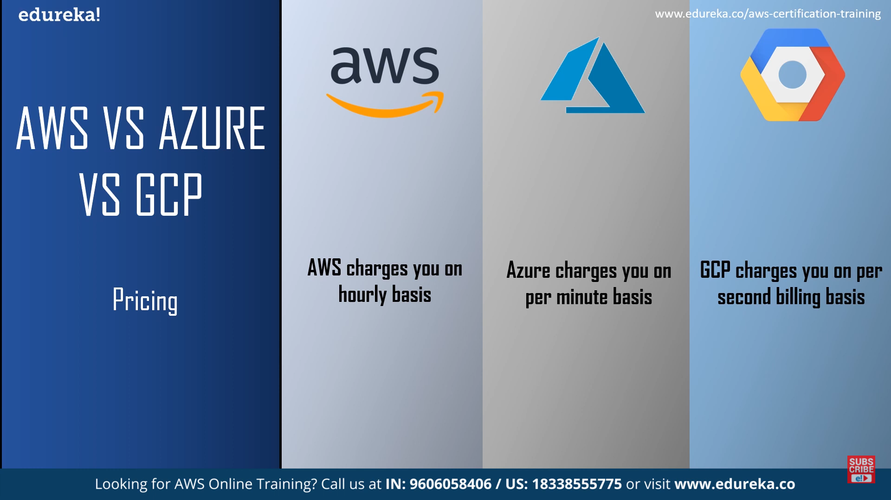

Slide 41
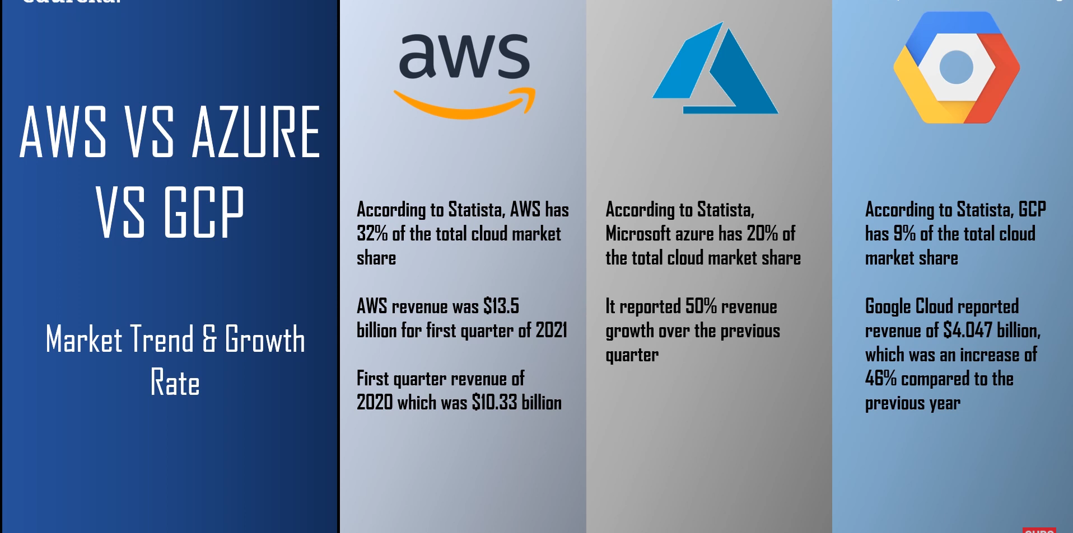

Slide 42
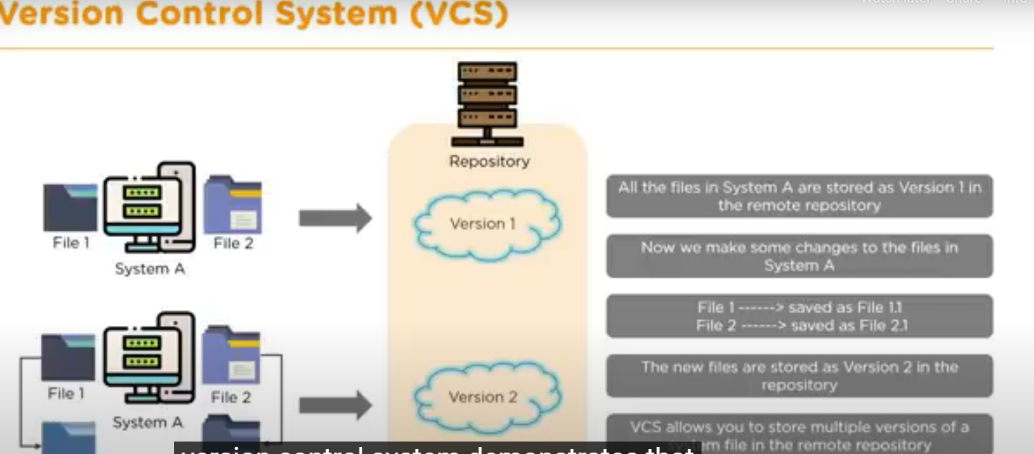

Slide 43
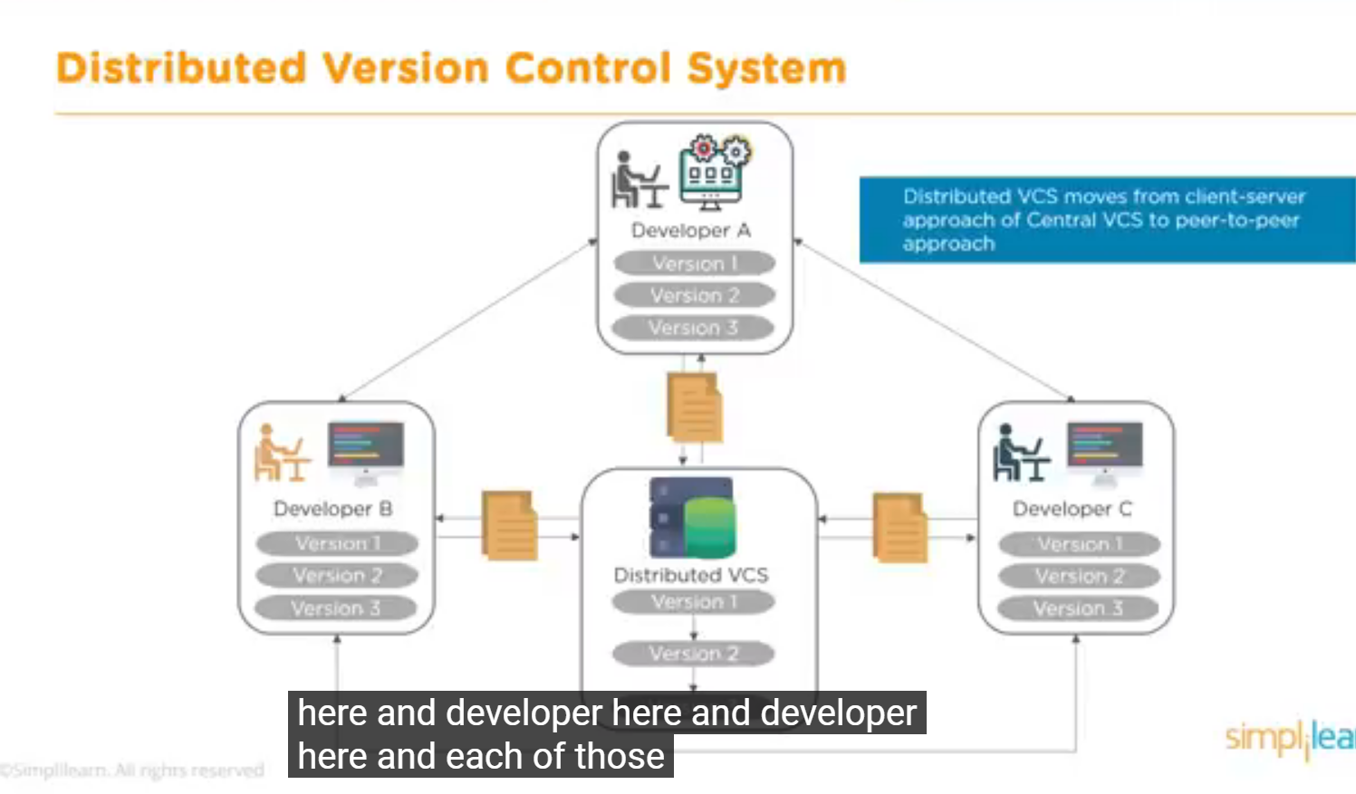

Slide 44
